Slide 1
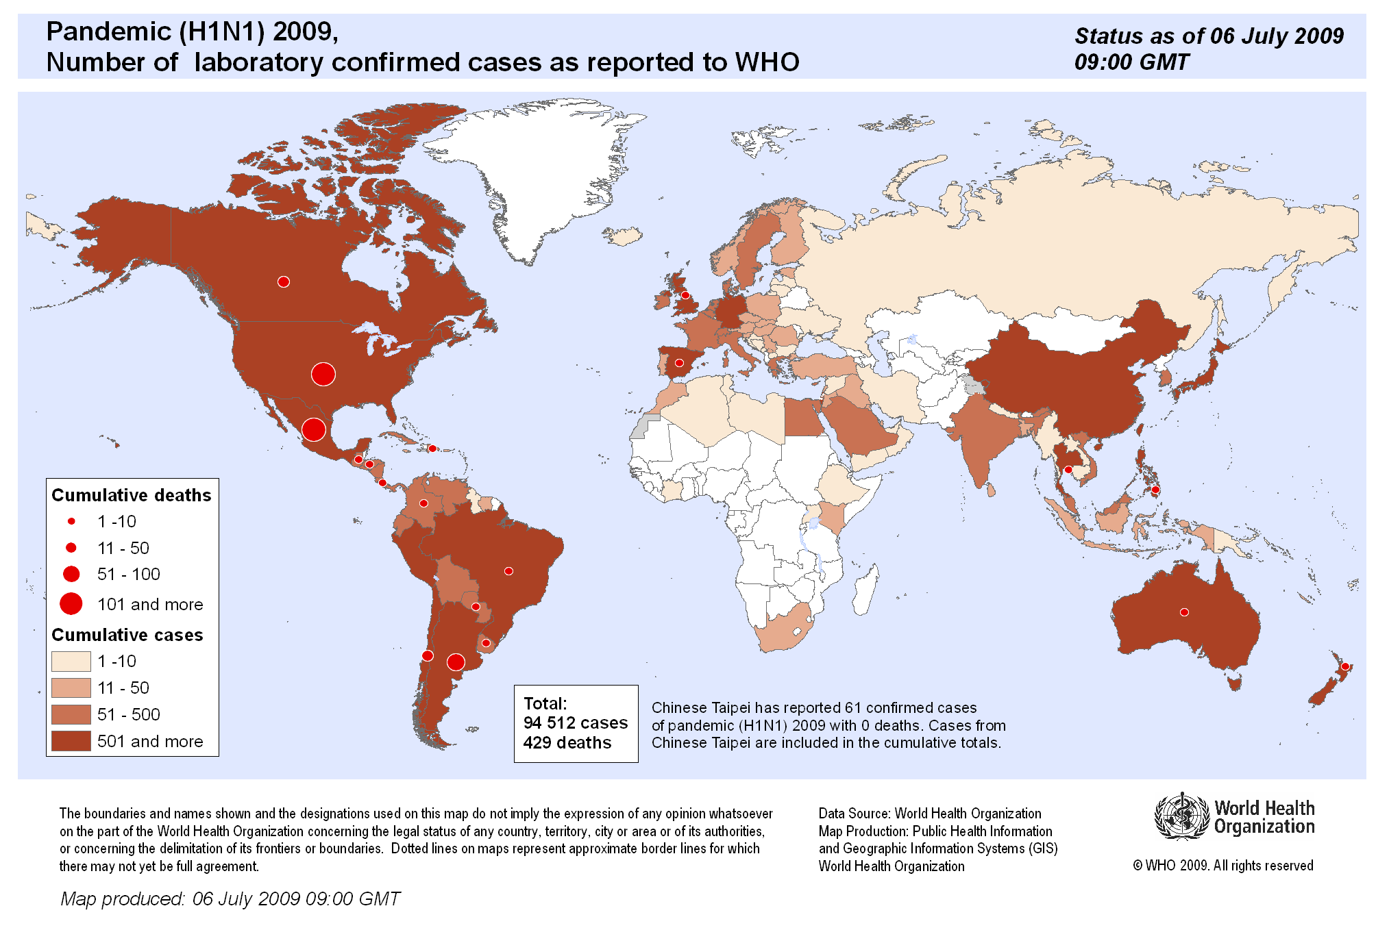


Analyzing Attributes of Global Outbreak
Group 2: Kati G., Saheed O. & Jorge R.
Notes:
Kati
Analyzed data on AH1 & H1N1 - this was pulled from 16 out of 42 countries in the Americas that made up 99% of the reported cases pulled from the WHO website & the World Bank for population density

Slide 2
Questions & Analysis Topics
Questions Asked:
How long would this outbreak last ?
Why specific areas of the globe are more affected than others?
Why are there so many cases in specific territories and not many in others?
What factors affect outbreaks
Analysis Topics:
Outbreak cycle trends
Outbreak relating to population density & region proximity
Outbreak relating to weather
Notes:
Kati

Slide 3
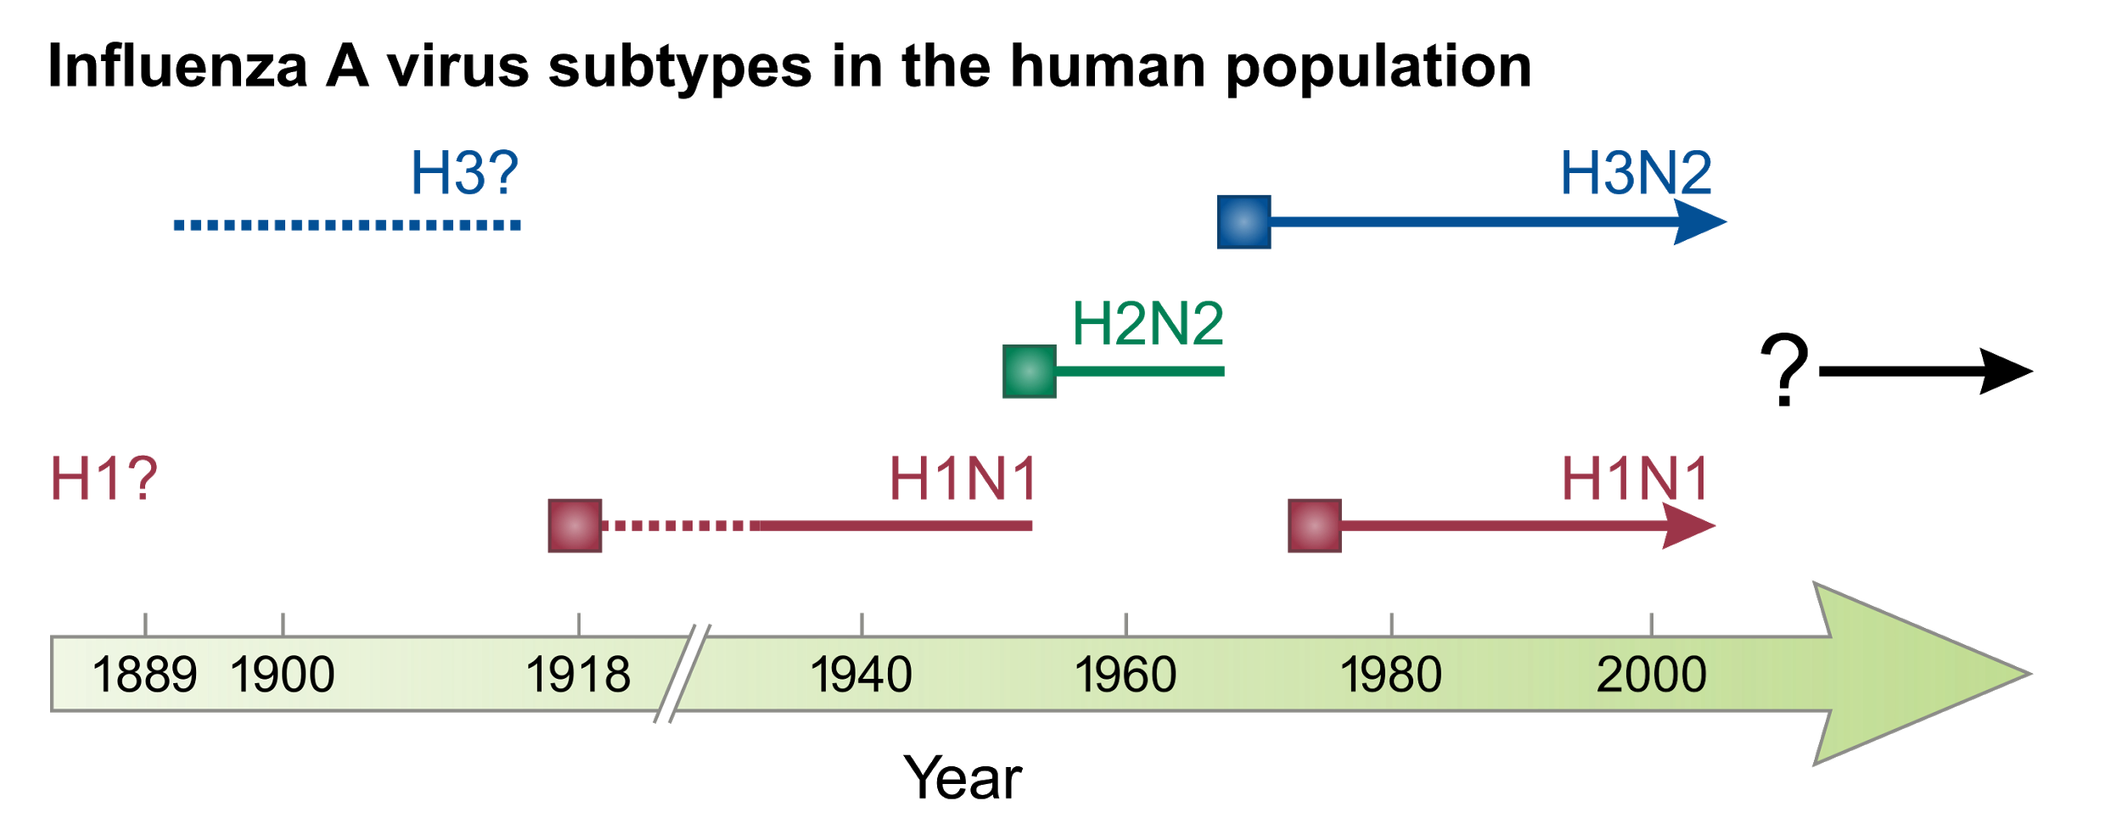
History and Background
Notes:
Saheed

Slide 4
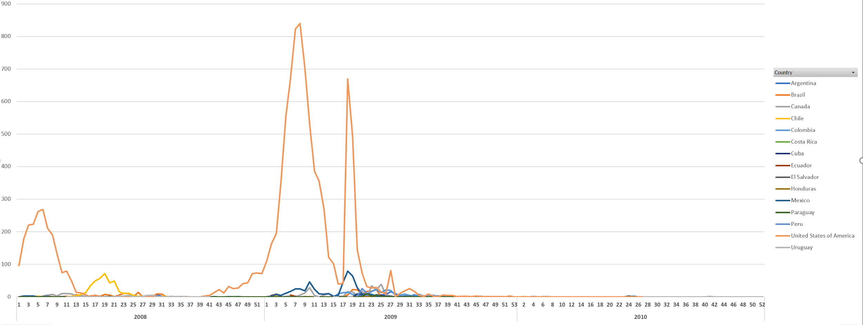
Recent Historical Outbreaks of AH1
Total Cases during 2008-2010 outbreak: 12,307
Notes:
Jorge Rueda
How important is for countries to address the outbreak is related to the numbers reported
Replication is based on number of cases reported - less cases reported more likely to reappear

Slide 5
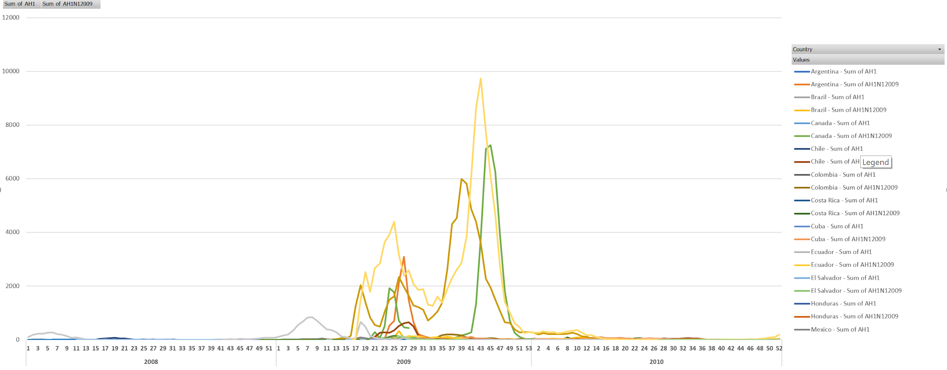
Recent Historical Outbreaks of AH1N1
Total Cases during 2008 - 2010 outbreak: 249,243
Notes:
Jorge Rueda

Slide 6
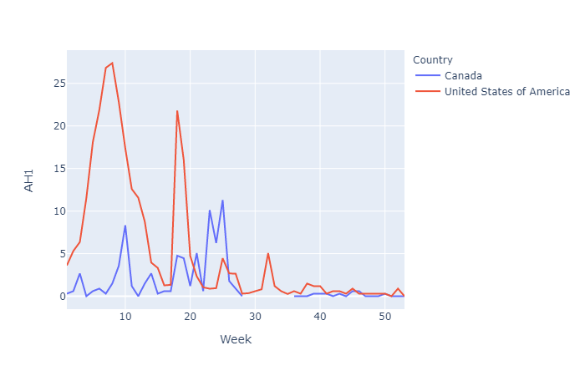
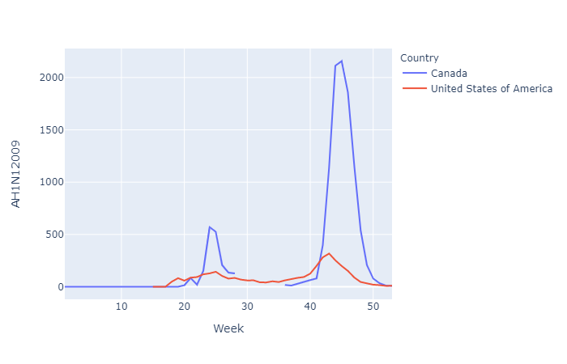
Life Cycle of Outbreaks - North America 2009
Total AH1 Cases 2009
United States : 7,947
Canada: 251
Total AH1N1 Cases 2009
United States: 105,982
Canada: 39,586
Notes:
When we began to analyze disease data
Realized US had most cases, but then normalized the data based on population

Slide 7
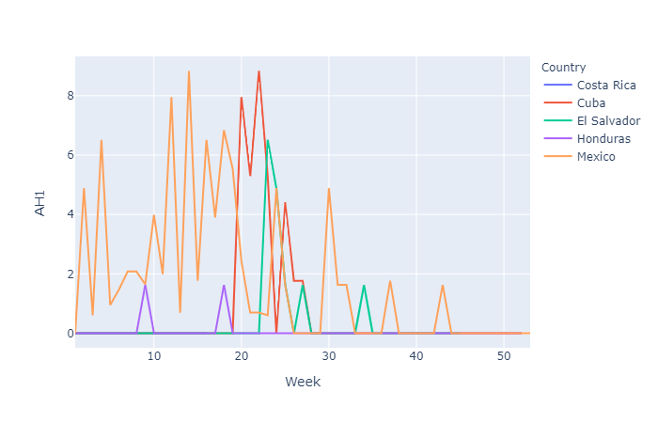
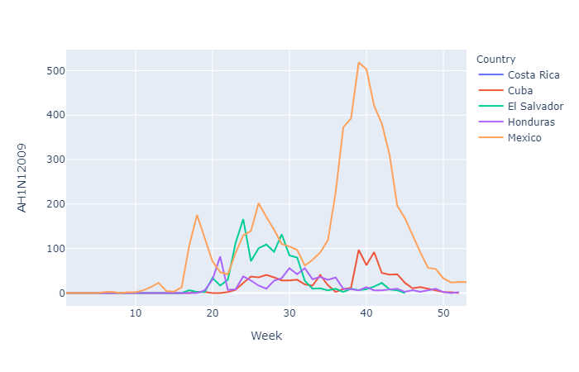
Life Cycle of Outbreaks - Central America 2009
Total AH1 Cases 2009
Costa Rica: 0
Cuba: 40
El Salvador: 10
Honduras: 2
Mexico: 462
Total AH1N1 Cases 2009
Costa Rica: 1
Cuba: 943
El Salvador: 774
Honduras: 606
Mexico: 69,922

Slide 8
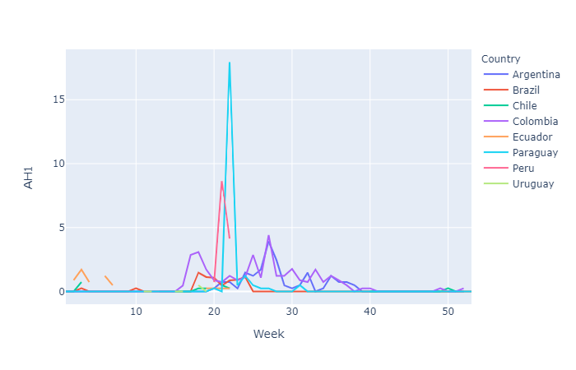
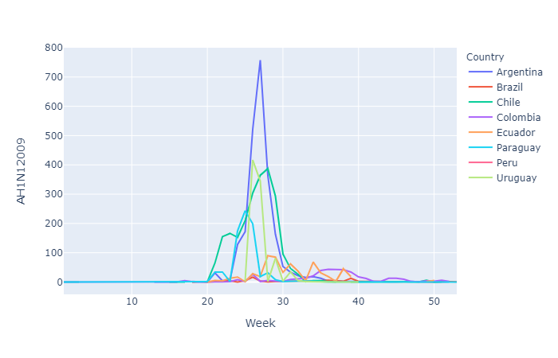
Life Cycle of Outbreaks - South America 2009
Total AH1 Cases 2009
Argentina: 77
Brazil: 117
Chile: 11
Colombia: 198
Ecuador: 25
Paraguay: 25
Peru: 40
Uruguay: 3
Total AH1N1 Cases 2009
Argentina: 9,514
Brazil: 1,577
Chile: 3,896
Colombia: 1,971
Ecuador: 1,302
Paraguay: 706
Peru: 0
Uruguay: 448

Slide 9
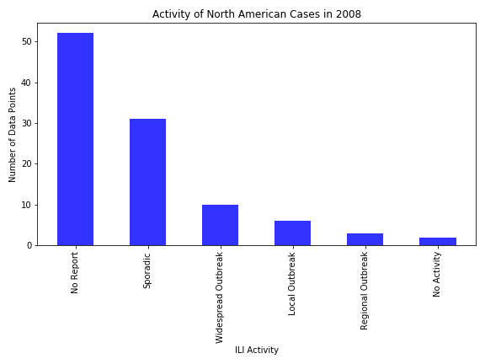
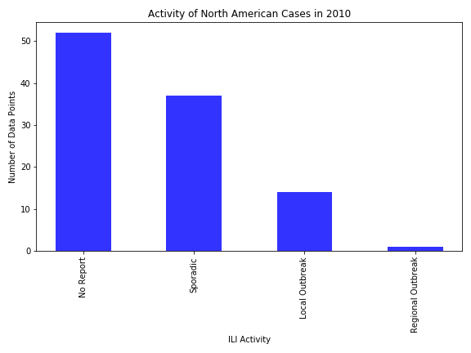
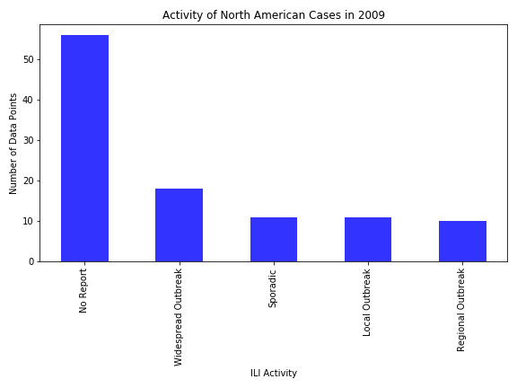
Influenza-Like Illness Activity Level- North America

Slide 10
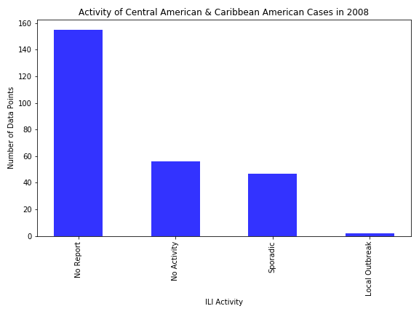
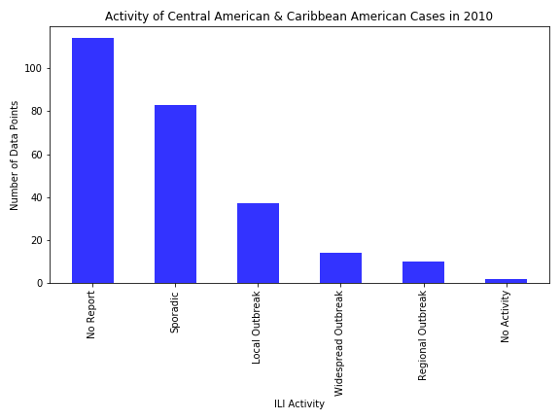
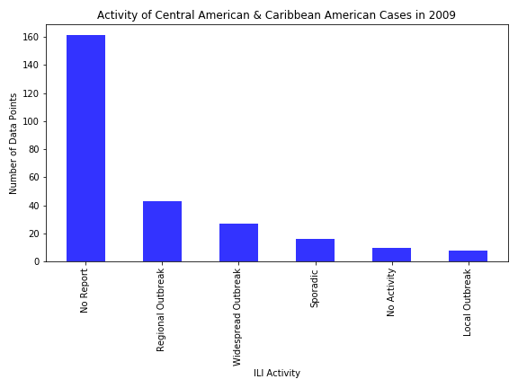
Influenza-Like Illness Activity Level - Central & Caribbean America

Slide 11
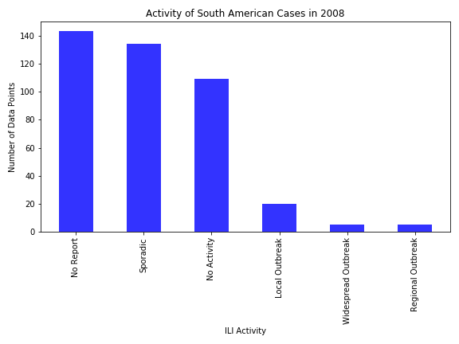
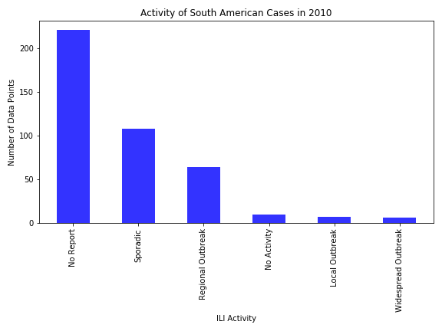
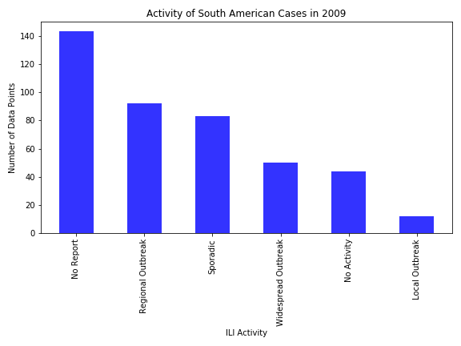
Influenza-Like Illness Activity Level- South America
Notes:
Most of the countries are

Slide 12
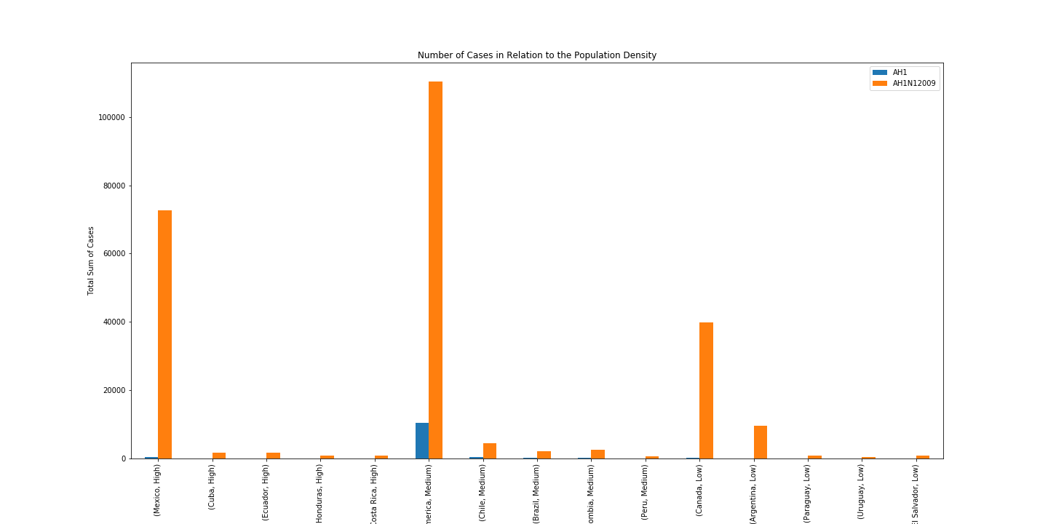
Population Density Pattern Analysis
For AH1 & AH1N1 we do not notice any correlation between the population density and the number of cases.
The levels for cases could be due to the proximity of the country.

Slide 13
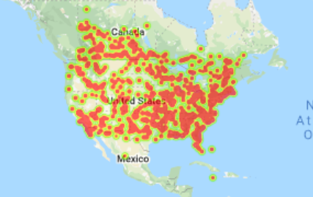
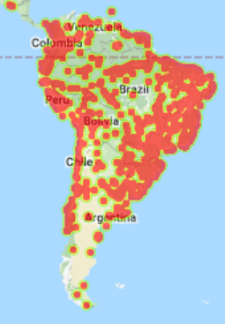
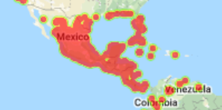
Weather Pattern Analysis
North America Temp. Pattern
South America Temp.Pattern
Central America Temp.Pattern

Slide 14
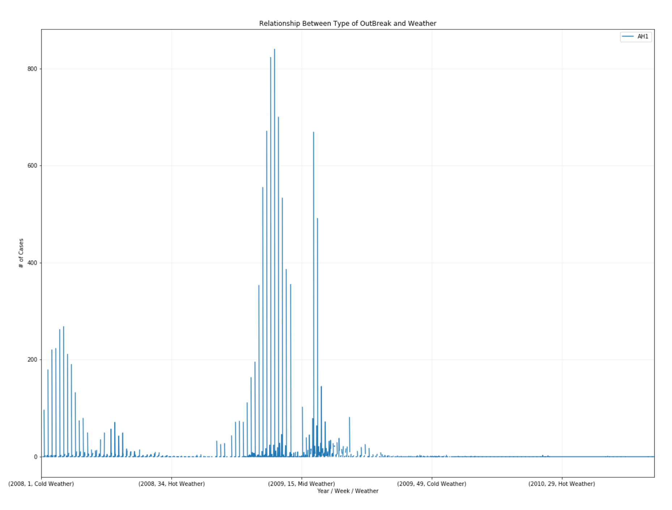
Relationship Between Outbreak of AH1 Weather Conditions
AH1 reported a considerable low rate of cases and its cyclical pattern is closely related to extreme weather conditions across the board.

Slide 15
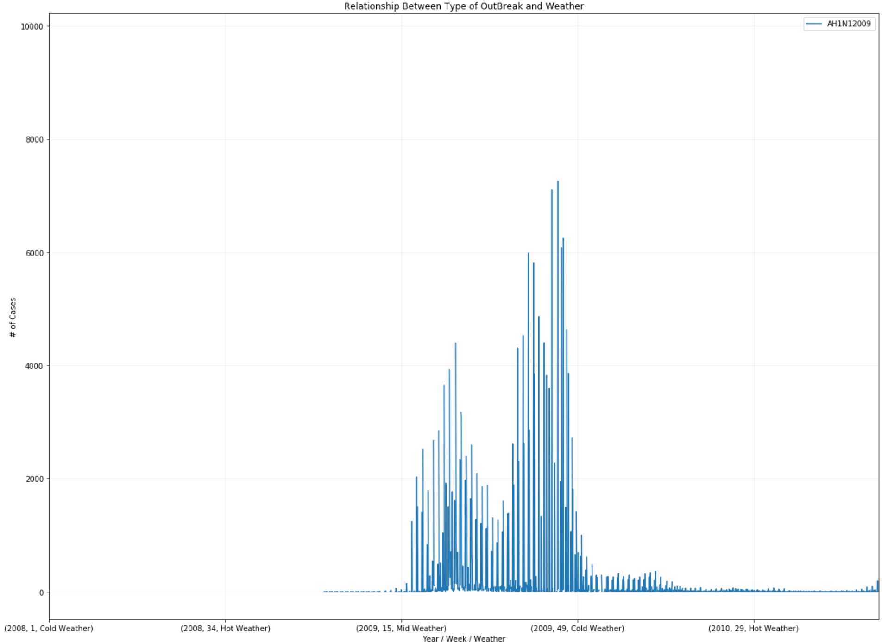
Relationship Between Outbreak of AH1N1 Weather Conditions
For H1N1 we noticed the trends replicated and had the same pattern as AH1.

Slide 16
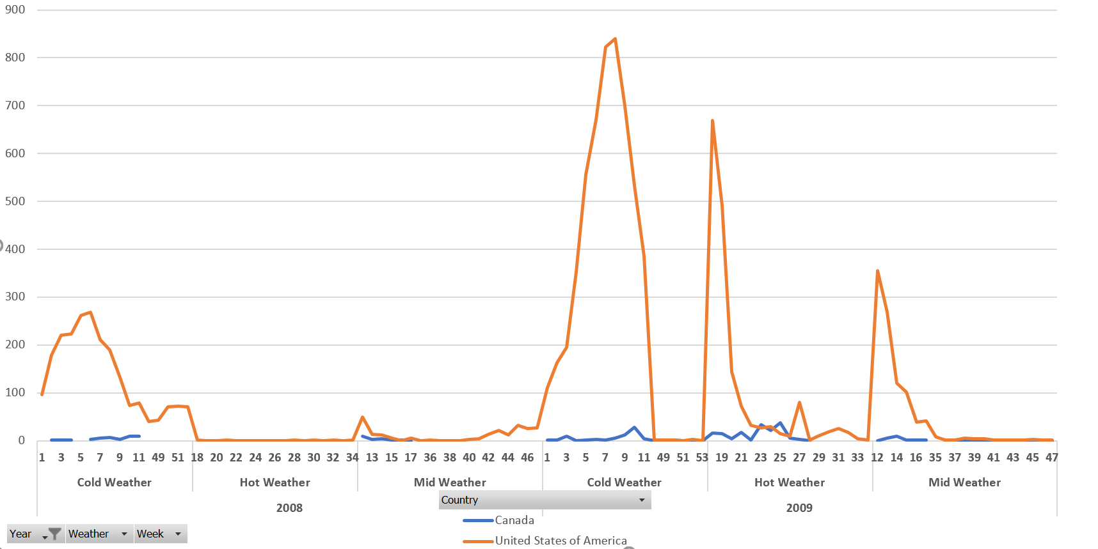
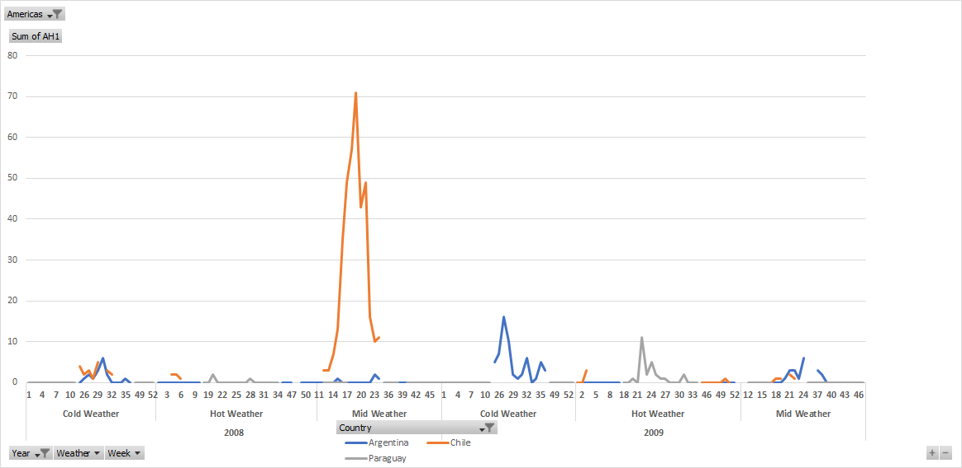
Relationship Between Outbreak of AH1 Weather Conditions by Countries
Going deeper in the information we notice how extreme weather conditions affect some countries more than others.

Slide 17
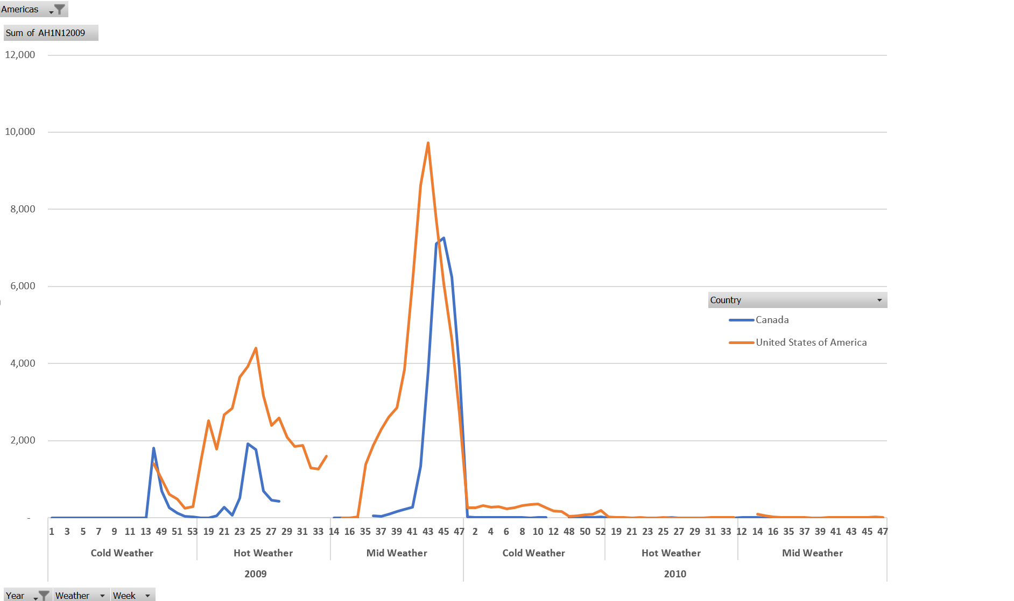
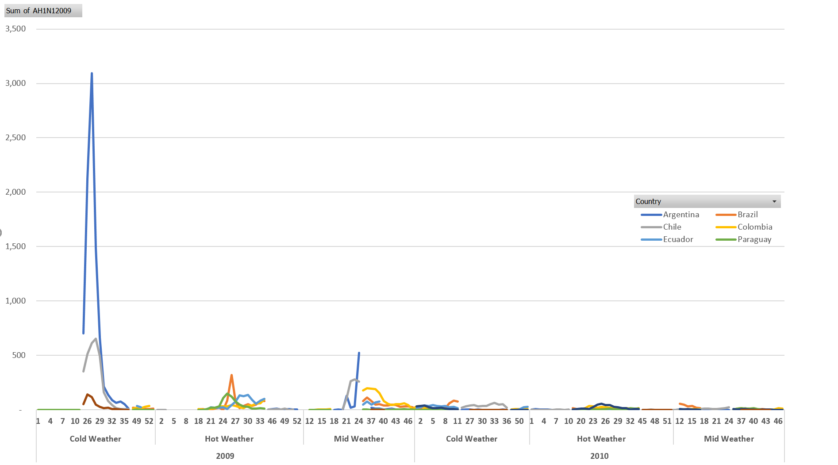
Relationship Between Outbreak of AH1N1 Weather Conditions by Country

Slide 18
Conclusions
Outbreaks follow a pattern, based on when they appear. Typically there are two spikes in a disease outbreak in its respective region.
There is no strong correlation between population density & number of cases. However, there is a correlation between region proximity and number of cases. One consideration we need to take into account is the amount of cases reported in its respective region.
There seems to be a close relationship between extreme weather conditions & disease outbreak. This is proven by the number of cases in the time frame of extreme weather conditions.
A Step Further:
Research economic indicators to see global outbreak effect on GDP
Historical data for a more detailed picture of trends

Slide 19
References
WHO - Main Data Source: http://apps.who.int/flumart/Default?ReportNo=12
Supplemental Data:
https://www.cdc.gov/flu/weekly/#VirusCharacterization
https://gis.cdc.gov/grasp/fluview/Novel_Influenza.html
https://www.climate.gov/maps-data/data-snapshots/averagetemp-monthly-cmb-2009-08-00?theme=Temperature
https://data.worldbank.org/indicator/EN.POP.DNST
Palese P (December 2004). "Influenza: old and new threats". Nature Medicine. 10 (12 Suppl): S82–87. doi:10.1038/nm1141. PMID 15577936.

